Slide 1
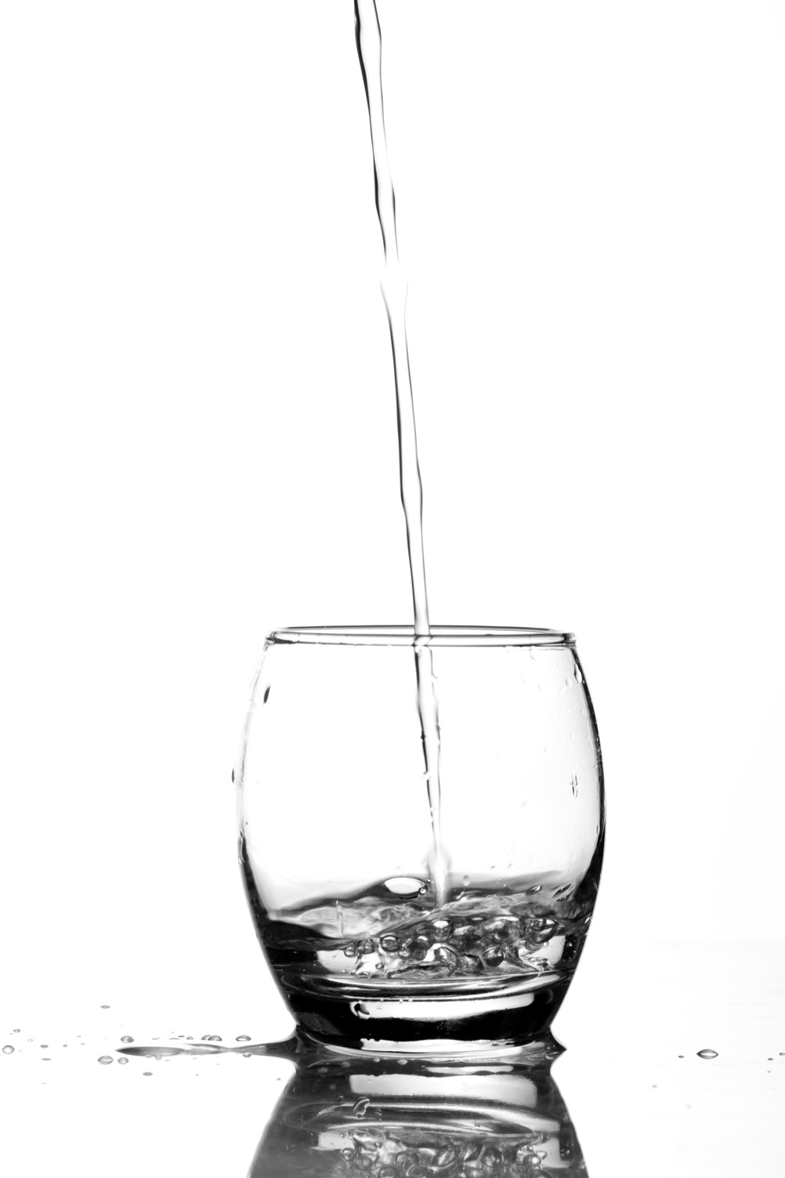
POTABILITY OF WATER
The Effect on Health and Safe Water Consumption
ADS502 Team 5
Andrew Abeles, Katie Hu, Emma Oo, Jake Burnett
16 Aug 2021

Slide 2

OVERVIEW
Water Potability
Data Analysis
Discussion
Data Cleaning
Data Prediction

Slide 3
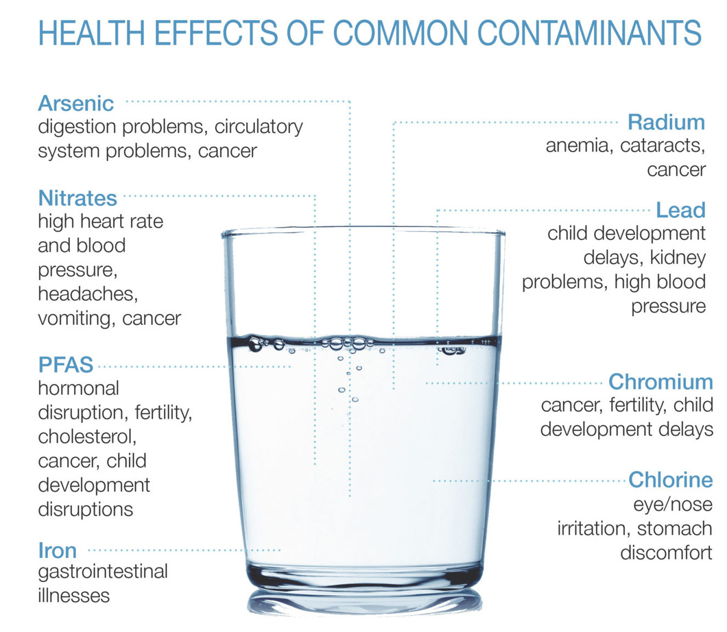
Water Potability
785
785 MILLION PEOPLE DON'T HAVE ACCESS TO CLEAN WATER
9%
ACCESS TO CLEAN WATER CAN PREVENT AT LEAST 9% OF GLOBAL DISEASES
6%
ACCESS TO CLEAN WATER CAN PREVENT AT LEAST 6% OF GLOBAL DEATHS
Water Quality Data Set
Imported as csv from Kaggle
Code via R Markdown
Objective
Notes:
785 Million People Lack Clean Water
Safe water has the potential to prevent at least 9% of the global disease burden and 6% of global deaths.
To break that down, 6% would mean it can prevent over 460 million deaths.

Slide 4
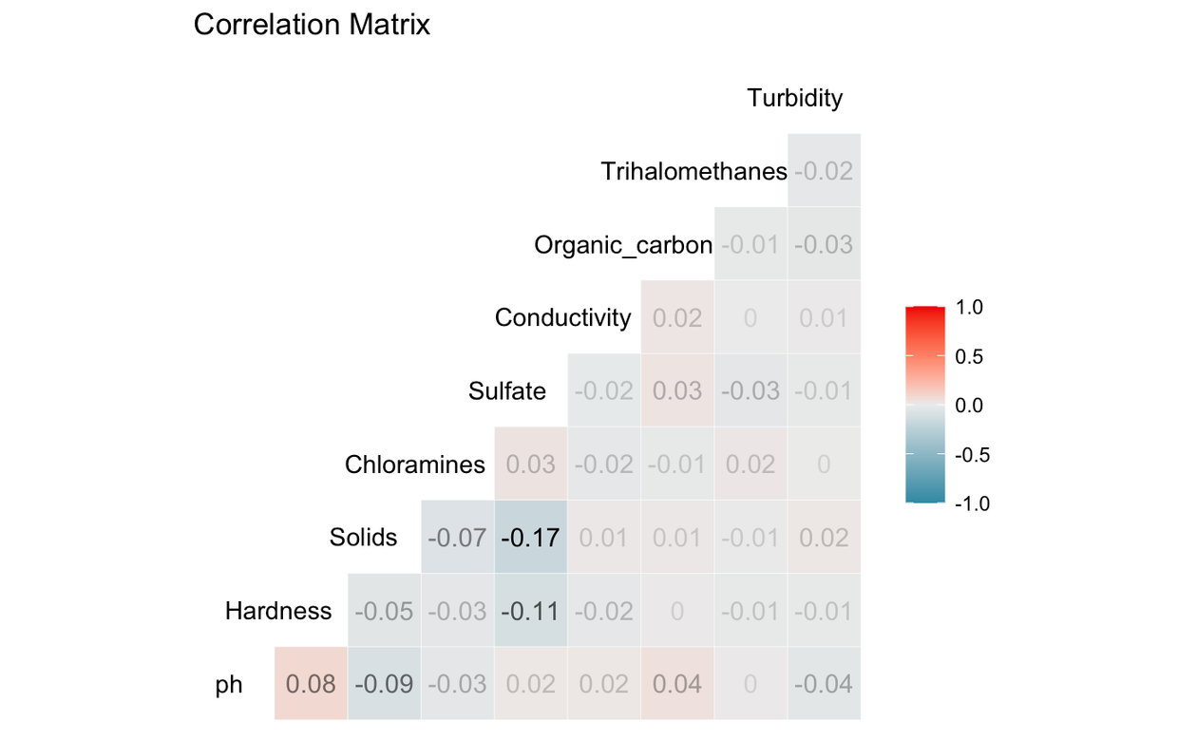
Data Cleaning
Missing Values
3 Variables:
Sulfate, pH, Trihalomethanes
Normal Distribution
Low Pairwise Correlation
Outliers
Z-Scores
4.5% Outliers Identified

Slide 5
Data Analysis
Dependent Variable (y): Potability
Predictor Variables (X): pH, Hardness, Solids, Chloramines, Sulfate, Conductivity, Organic Carbon, Trihalomethanes, Turbidity
10
Exploratory Analysis Picture

Slide 6
Data Prediction
k-Nearest Neighbor
Logistic Regression
Decision Tree
Insert Text?
Insert Text?
Insert Text?

Slide 7
Prediction Method
Method: k-Nearest Neighbor
TEXT
Text

Slide 8
Prediction Method
Method: Decision Tree - Cart & C5.0
TEXT
Text

Slide 9
Prediction Method
Method: Multinomial Logistic Regression
TEXT
Text

Slide 10
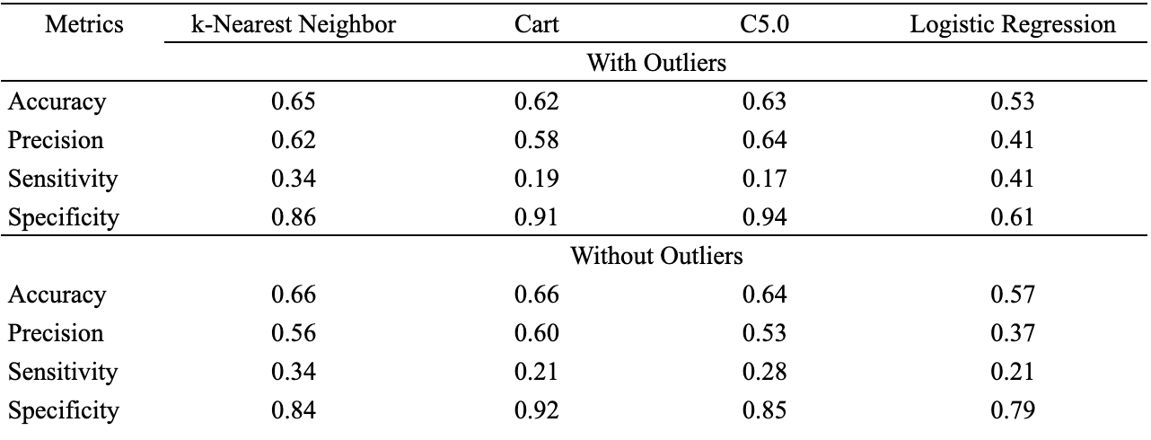
Discussion
Selected Method:k-NN
Model Metrics

Slide 11
Thank you!
Citations
Photo in Water Potability Page: https://haguewaterofmd.com/common-water-contaminants/
Water Potability Page Facts:
https://www.cdc.gov/healthywater/global/wash_statistics.html
https://www.worldvision.org/clean-water-news-stories/global-water-crisis-facts

